Slide 1
2D game environment and world development
Course : 2D Game Programming
Effective Period : September 2018

Slide 2
These slides have been adapted from: Pereira, V. (2014). Learning Unity 2D Game Development by Example, Packt Publishing, Inc. San Francisco. ISBN: 9781783559046 Chapter 2
Acknowledgement

Slide 3
Learning Objectives
LO 1 : Create 2D game for PC platform
LO 3 : Design 2D game for PC platform

Slide 4
What 2D game environment that you like?
Is there a timeless or nostalgic meaning to the game environment?

Slide 5
What is an environment in 2D games?
"In many 2D tile-based games, the background is very unobtrusive. It is typically a very large distance from the game plane, meaning that there is no ambiguity as to whether or not something is part of the background or the playground. All of this amounts to a very clear level." – Chris McEntee, 2013

Slide 6
What is background?
A background is the image or images that are furthest from view, usually behind the characters and objects in the game.
It adds a scene to our game, an environment that our game will take place in, to immerse the players in the game world.
Sometimes, a background can be static (non moving) and most of the time the player cannot interact with the background as it is more of a visual element to provide the setting, tone, and mood of the game.

Slide 7
Two methods to set a background
Using a static image
Using a tileset

Slide 8
Setting a background using a static image

Slide 9
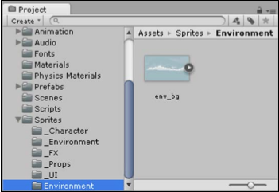
Setting a background using a static image
Access your images in the project
Image source:
Pereira, V. (2014). Learning Unity 2D Game Development by Example. Packt Publishing, Inc. San Francisco.

Slide 10
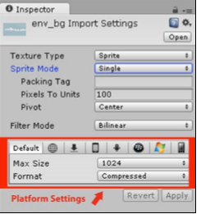
Open the sprite inspector
Image source:
Pereira, V. (2014). Learning Unity 2D Game Development by Example. Packt Publishing, Inc. San Francisco.

Slide 11
Sprite Inspector
For Texture Type when we click on the drop-down box next to Texture Type, we are presented with the types of textures that Unity makes use of, As we are working in 2D, we would like to use an image, and therefore, a sprite, as our background. Thus, we will select Sprite as our Texture Type.
For the Sprite Mode, we are presented with two options: Single and Multiple, choose Single as we want to create only one sprite that uses the whole image.

Slide 12
Sprite Inspector
The Pixels to Units property is used when we import an image and it either appears much smaller or much larger than intended.
The Pivot property sets the point on the image from where you would like to move it.
The Filter Mode setting determines how the texture used for the sprite gets filtered.
The Max Size setting sets the maximum size when importing the texture for our background sprite.

Slide 13
Sprite Format
There are several options available that will represent the image internally:
Compressed: This is the default and is the most commonly used option, being the smallest in size
16 bits: This option is for images that are larger in size and higher in quality than Compressed, but lower in quality when compared to Truecolor
Truecolor: This is the highest quality option, but the largest in size

Slide 14
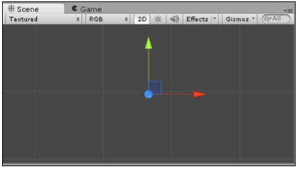
Let’s Start creating the background
Select the GameObject drop-down box from the top toolbar by going to GameObject | Create Other | Sprite.
The GameObject we have just created will be empty within the Scene
Image source:
Pereira, V. (2014). Learning Unity 2D Game Development by Example. Packt Publishing, Inc. San Francisco.

Slide 15
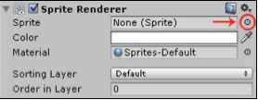
The Background
We need to assign the sprite asset we created to the GameObject by clicking on the circle next to Sprite
Image source:
Pereira, V. (2014). Learning Unity 2D Game Development by Example. Packt Publishing, Inc. San Francisco.

Slide 16
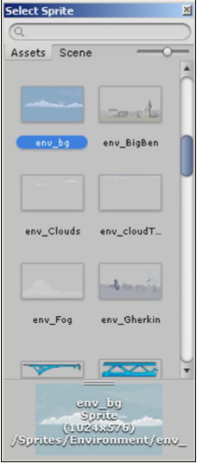
The Background
Under the Assets tab, we can find and select our asset,
Image source:
Pereira, V. (2014). Learning Unity 2D Game Development by Example. Packt Publishing, Inc. San Francisco.

Slide 17
GameObject Inspector
The settings that we set for the GameObject within the Inspector will take effect within the Scene View
Position Background
To position the background so that it fits perfectly within the 2D Camera View, we go to Inspector | Transform | Position and set the following values: X = 0, Y = 0 and Z = 0
Color background
We also have the option to color the background or use advanced artistic effects by choosing shaders to use on the material of our image. Unity comes with a basic set of shaders.
Layer background
We can leave our background on the default layer as it needs to be beneath all the images that we will create on layers above it. This layer is known as the Sorting layer.

Slide 18
GameObject Inspector
Position Background
To position the background so that it fits perfectly within the 2D Camera View, we go to Inspector | Transform | Position and set the following values: X = 0, Y = 0 and Z = 0
Color background
We also have the option to color the background or use advanced artistic effects by choosing shaders to use on the material of our image. Unity comes with a basic set of shaders.

Slide 19
Setting a background using a tileset

Slide 20
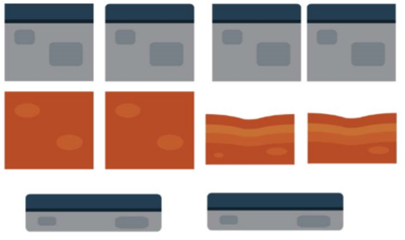
GameObject Inspector
Tilesets are sets of tiled images that are used to create the scene.
Some games, especially platform games, puzzle games, and sandbox games use tilesets to create their backgrounds. Using a tileset makes it easier to create and edit those types of games because the tiles get reused to make the scene in different variations.
Image source:
Pereira, V. (2014). Learning Unity 2D Game Development by Example. Packt Publishing, Inc. San Francisco.

Slide 21
Tilesets require the following
Seamless textures
The images that will be used as tiles within a tileset need to be seamless and of equal or matching size. This is so when you duplicate them and then arrange them next to each other or above one another, they will then blend nicely together to create the bigger picture.
Corner pieces
Depending on the type of game we would like to create, we will more than likely require corner pieces when creating a tileset to round off the edges of a section of the background and break up the repetition. We need to ensure that the corner pieces can be rotated and fit together from all angles.

Slide 22
Tilesets require the following
The grid settings
To easily and accurately place our tiles, we need to work with a grid that the tiles snap onto so that the tiles fit and match together properly. To edit the Unity grid settings as per our own liking, we go to Edit | Snap Settings…. We then hold Crtl + drag to place and snap our tiles onto the grid.
Creating a prefab
A prefab is a reusable GameObject. When we add a prefab to the scene, then an instance of that GameObject is created. This means that if we make any changes to the prefab, then all the instances will automatically change, saving us a lot of time. Therefore, when dealing with a tileset, it is a good idea to create a prefab of each unique tile by dragging the GameObject in the Hierarchy tab into the Project Browser. The name of your GameObject in the Hierarchy tab will turn blue to signify that it is now a Prefab.

Slide 23
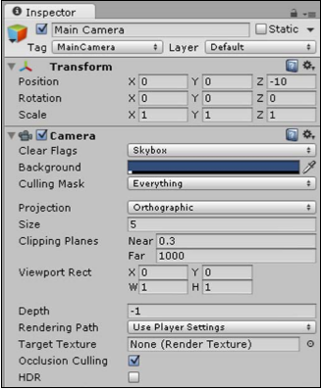
Camera Settings
We will go through the camera settings to understand them. When we click on the Main Camera option in our scene, we get the following settings within the Inspector.
Clear Flags: This sets which parts of the screen are to be cleared.
Background: This selects which color to display behind all the objects in our scene if we have not added a skybox, background, or image that takes up the whole screen.
Culling Mask: This selects which layers are to be rendered by the camera.
Projection: We select Perspective if we want to work in 3D and Orthographic to set our camera mode to 2D.
Size: This is the size of the camera in Orthographic (2D) mode
Clipping Planes: This sets the distances from the camera that we would like to begin and end rendering.
Image source:
Pereira, V. (2014). Learning Unity 2D Game Development by Example. Packt Publishing, Inc. San Francisco.

Slide 24
Camera Settings
We will go through the camera settings to understand them. When we click on the Main Camera option in our scene, we get the following settings within the Inspector.
Viewport Rect: This consists of the camera's x and y coordinates followed by its width and height. • Depth: This is the draw order of the camera. Cameras with bigger values will be drawn above cameras with smaller values.
Rendering Path: This defines advanced rendering methods used by the camera.
Target Texture: This references the output of the Camera View to a Render Texture (pro-only feature).
Occlusion Cullling: This disables rendering of objects not seen by the camera
HDR: This sets High Dynamic Range rendering. (An advanced rendering technique—visual effect that reproduces a more dynamic range of luminosity).
Image source:
Pereira, V. (2014). Learning Unity 2D Game Development by Example. Packt Publishing, Inc. San Francisco.

Slide 25
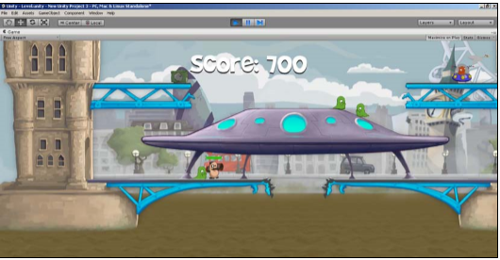
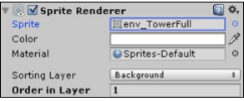
Foreground?
For the foreground, we go through the same steps as we did for the background, the only difference being that we will need to set the foreground images to layers above the background.
Image source:
Pereira, V. (2014). Learning Unity 2D Game Development by Example. Packt Publishing, Inc. San Francisco.

Slide 26
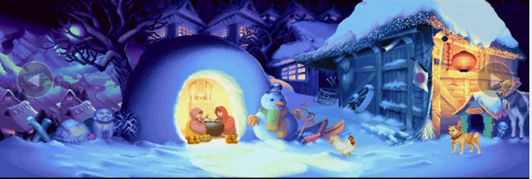
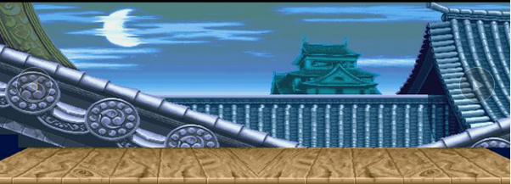
Backgrounds
Img source :
http://www.gamesradar.com/27-most-amazing-fighting-game-backgrounds/

Slide 27
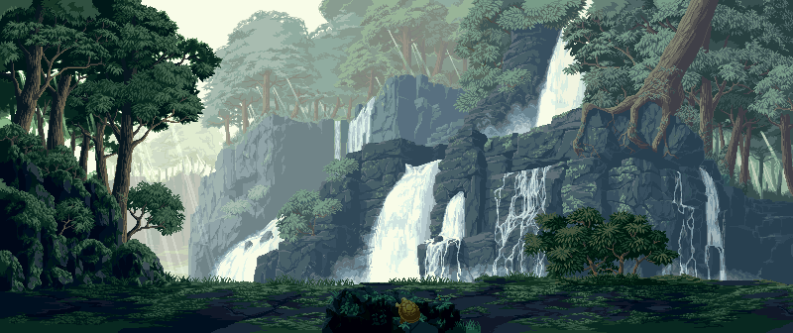

Slide 28
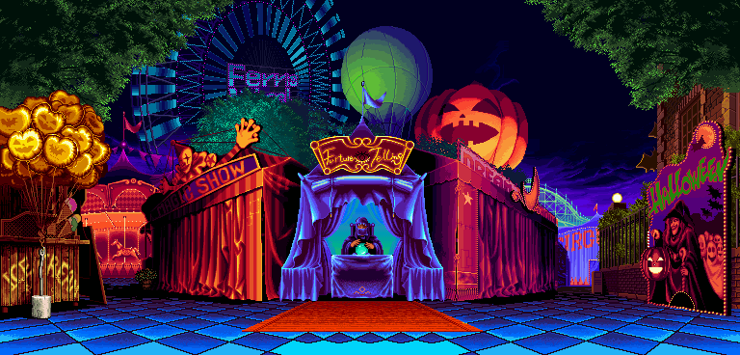

Slide 29
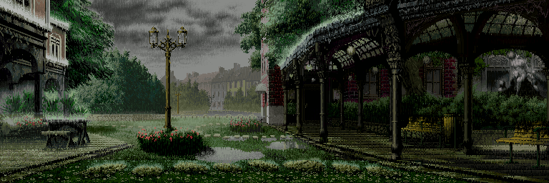

Slide 30
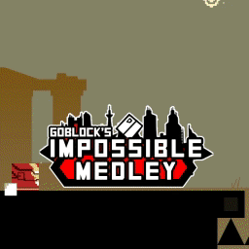
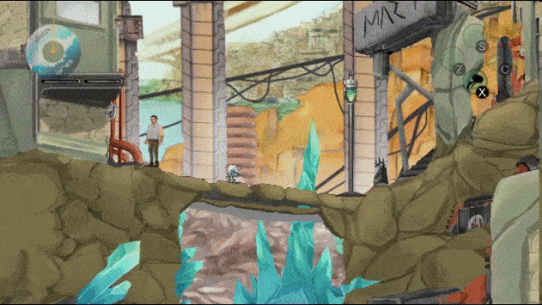

Slide 31
Discussion
What is your favorited 2D background?
Is there a more obscured way to implement game background?
Discuss with your team, what kind of background you are going to use in your game

Slide 32
References
Freeman, J. (2015). Unity’s New 2D Workflow
Vidyasagar. (2014. Unity and C#: Game Loop.CodeProject
Pereira, V. (2014). Learning Unity 2D Game Development by Example. Packt Publishing, Inc. San Francisco. ISBN: 9781783559046

